Slide 1
Step 1: Install the build-essential packages
In order to compile and execute a C program, you need to have the essential packages installed on your system. Enter the following command as root in your Linux Terminal:
$ sudo apt-get install build-essential

Slide 2
Step 2: Write a simple C program
After installing the essential packages, let us write a simple C program.

Slide 3
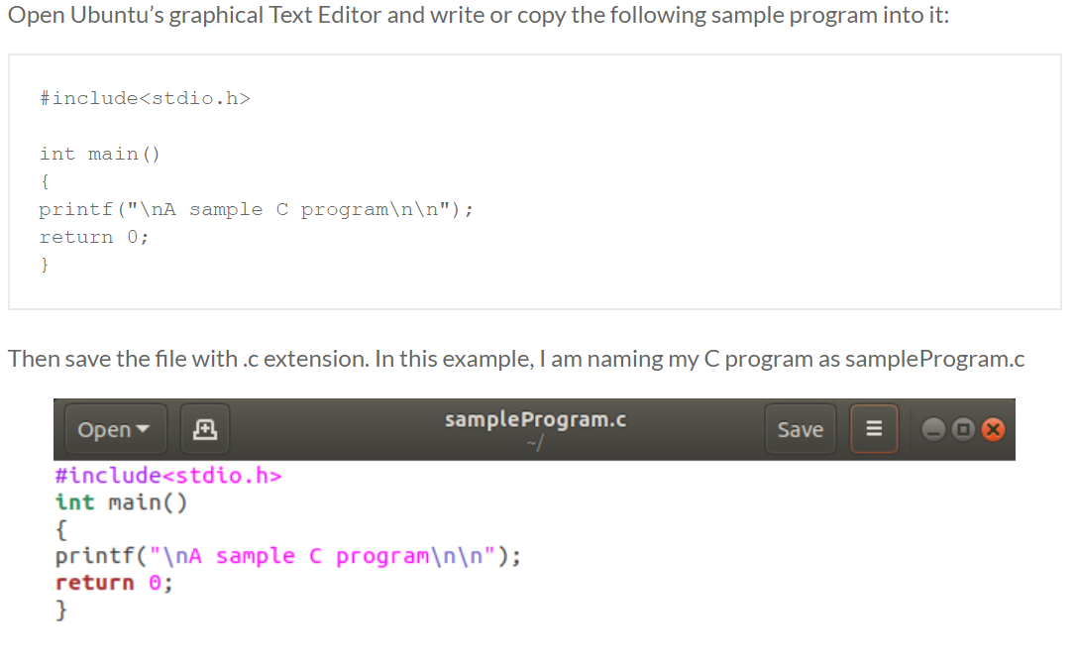

Slide 4
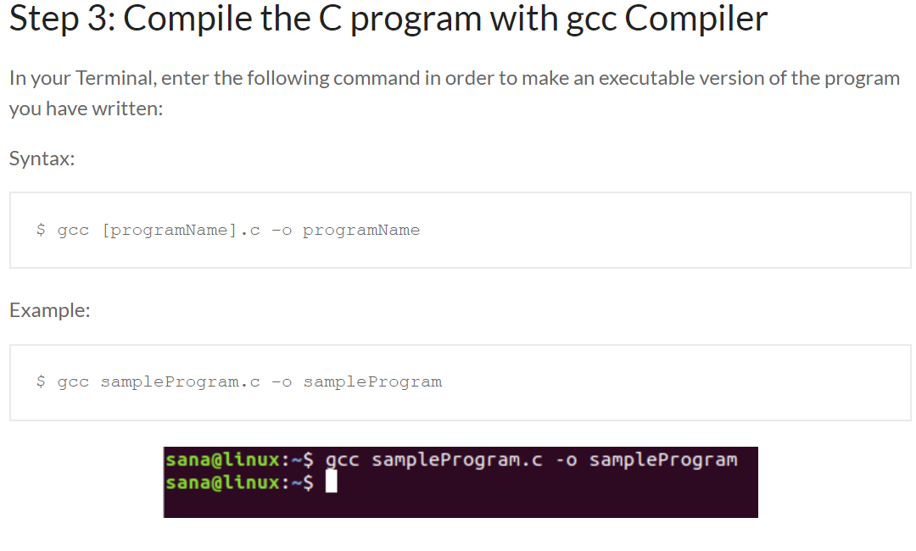

Slide 5
